Slide 2
Rabies
Hydrophobia, lyssa or lytta
^{By}
Dr/ Marawan Elfky

Slide 3
Definition
Severe worldwide, viral disease that can affect all mammals, including humans.
Infection results in damage to the nervous system and always ends with death.

Slide 4
Etiology
large RNA neurotropic virus of genus lyssavirus ,family rhabdoviradae,
Susceptible to boiling and common disinfectants as ether, chloroform, formalin and sod hydroxide.
Dies in dried saliva in few hours
Persist in infected brain tissue for 7-10.d at room temperature and for several weeks at 4°c.

Slide 5
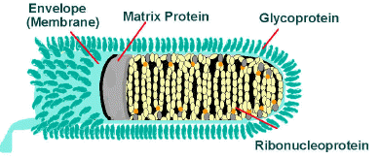
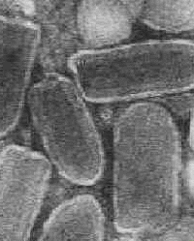

Slide 6
Epidemiology
Distribution: Worldwide and recorded in Egypt.
Host rang: (All mammals, including domestic and non-domestic animals and humans).
Young more than adult.
Less common guinea pigs, rabbits and pig
Wildlife, raccoons, skunks, mongoose, bats are major reservoirs (immune carriers).
Notes:
foxes, wolves, jackals and coyotes are extremely susceptible, cattle, rabbits and cats are highly susceptible, dogs, sheep and goats are moderate in susceptibility while man is intermediate in susceptibility
bats are major reservoirs (immune carriers). virus is multiply within bats in its fatty tissue without invasion of nervous tissue resulting in latent infection and rarely show signs

Slide 7
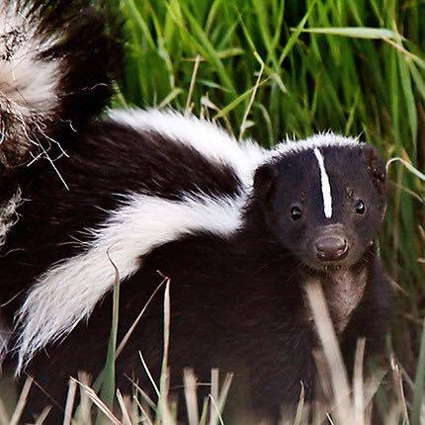
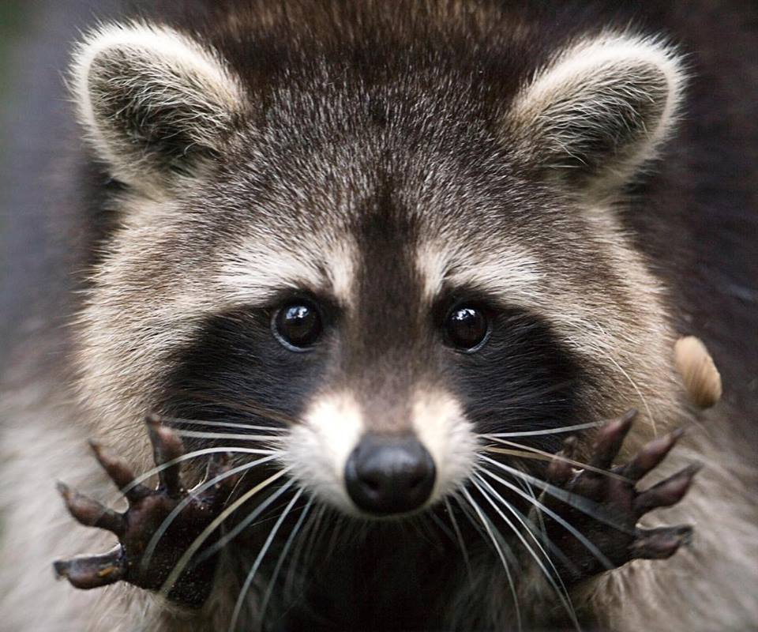
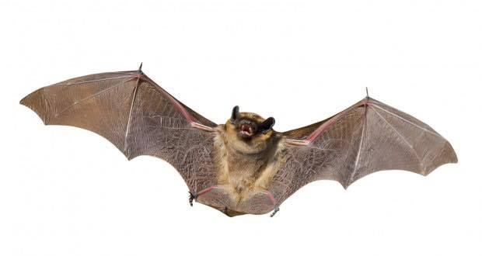
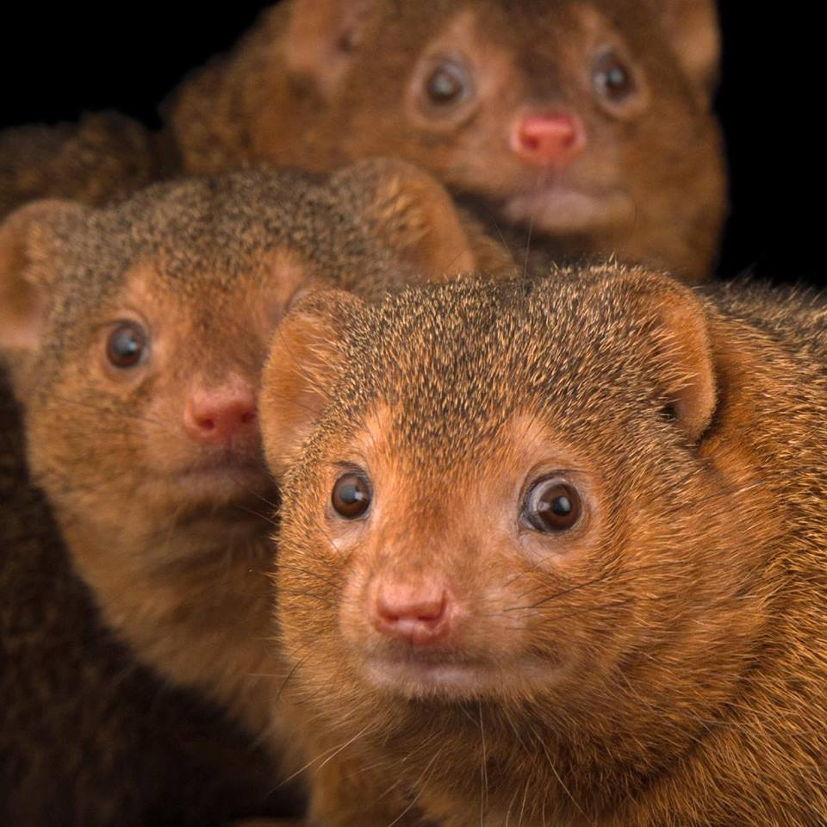

Slide 8
Seasonal incidence: Late summer and autumn because of large scale movement of wildlife at mating and pursuit of food .
Transmission:
Source: infected saliva of rabid animal.
Mode:
Primary, biting of rabid animals.
Occasionally, open wound or mucous membrane exposure to saliva of rabid animal.

Slide 9
5. Economic and zoonotic impact:
Rabies considered a very dangerous disease with significant economic losses due to deaths’ in animals and human.
The disease is zoonotic

Slide 10
Pathogenesis
After biting of cattle by infected animal or wound contamination by the virus, spreading occur through the body via the bloodstream.
Then the virus travels to the spinal cord and brain, at which point clinical signs of rabies often appear in cattle

Slide 11
Clinical signs
I.P from 2 weeks to 6 months with short course (1-10 d.)
Low morbidity rate and high mortality.
There are 2 forms of the disease:
Furious form
Dumby form

Slide 12
Furious form
Sudden behavior changes, and attack without stimulation with eating abnormal substances.
Animals may be anxious, highly excitable and/or aggressive with intermittent periods of depression.
Abnormal bellowing, which may continue intermittently until shortly before death.
As the disease progresses, muscular weakness, incoordination, seizures and death.

Slide 13
B. Dumby form
Cattle converted to be docile with depression.
Paralysis, generally of the face, throat and neck, causing abnormal facial expressions, drooling of saliva and inability to swallow.
Paralysis may affect the body, first affecting the hind legs then progresses rapidly to the whole body with subsequent coma and death.

Slide 14
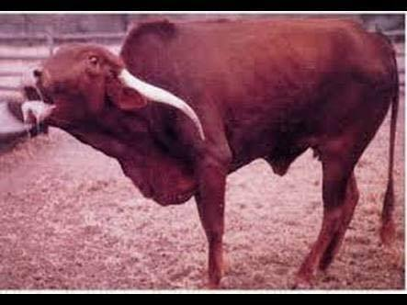
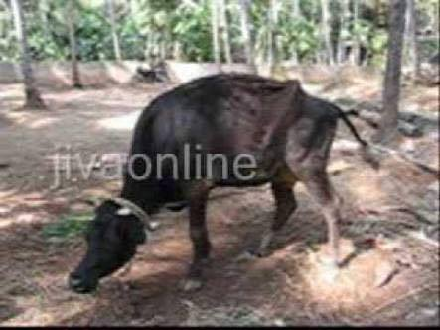
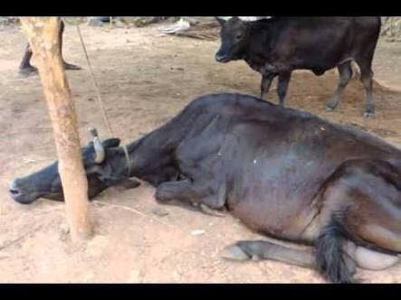
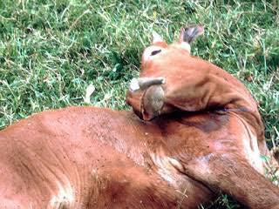

Slide 15
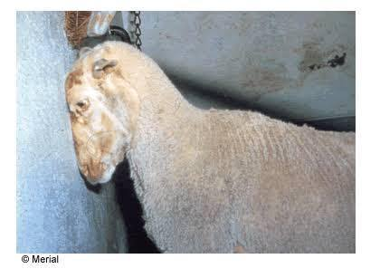
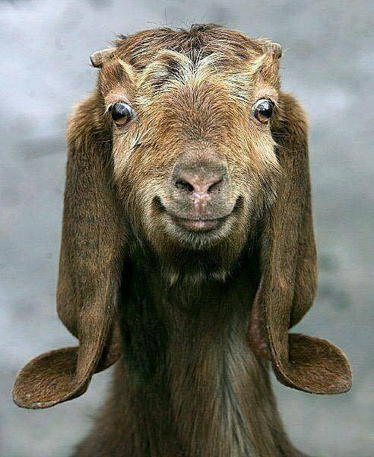

Slide 16
P/M lesions
There are no pathognomonic lesions except congestion and edema of meninges and brain.
foreign materials in stomach of rabid cattle indicating depraved appetite

Slide 17
Diagnosis
1- Field diagnosis; depends on case history, clinical signs and P/M lesions.
2. Lab. Diagnosis;
Sample:
Head as a whole or brain, and smear or slices from brain and spinal cord.
Salivary glands, saliva and nasal discharges.
Serum

Slide 18
Diagnosis
Laboratory procedures:
Virus isolation on cell culture (CPE after 18-24.h)
Microscopic examination of tissue smears after staining with seller’s stain to detect intracytoplasmic inclusion bodies or Negri bodies (red or purpulish).
Immunohistochemistry and IF to detect the virus in brain tissue.
Serological tests as virus neutralization test

Slide 19
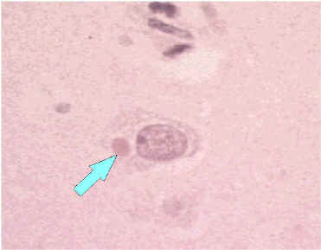
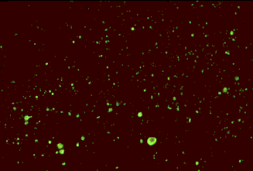
Negri bodies
Rabies by IF

Slide 20
Differential Diagnosis
The disease should be differentiated from all causes of nervous manifestation as in BSE:

Slide 21
Treatment
No treatment should be attempted after appearance of signs.
Post exposure prophylactic measures:
immediately after exposure or biting, irrigation of the wound by 20 % soaps and water may prevent virus attachment, suture of deep wounds with infiltration of the wound with anti-rabies immune sera.

Slide 22
Control & vaccination
The main goal of animal’s rabies control is to reduce or prevent infection of humans
Depending on:
Surveillance and reporting of suspected cases of rabies in animals
Vaccination programs for domestic animals
Wildlife rabies control programs.

